Slide 1
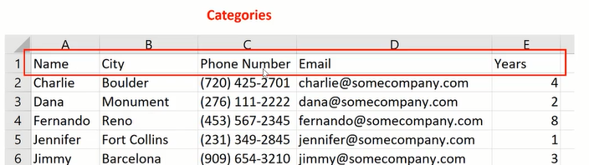
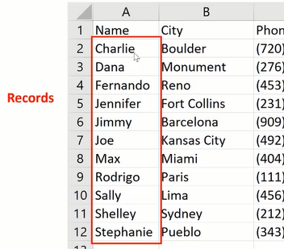
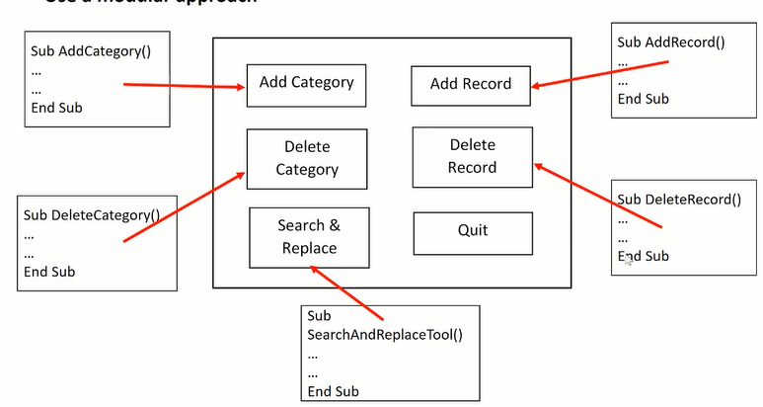
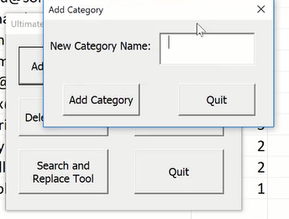
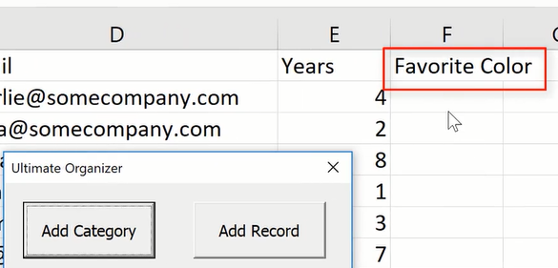
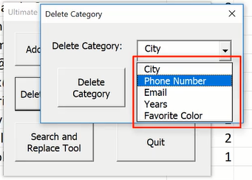
Week 3 Ultimate Organizer
1) Form1Main looks like this
2) UserForm needed
UserForm with ComboBox. Never delete names

Slide 2
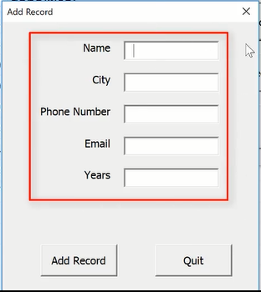
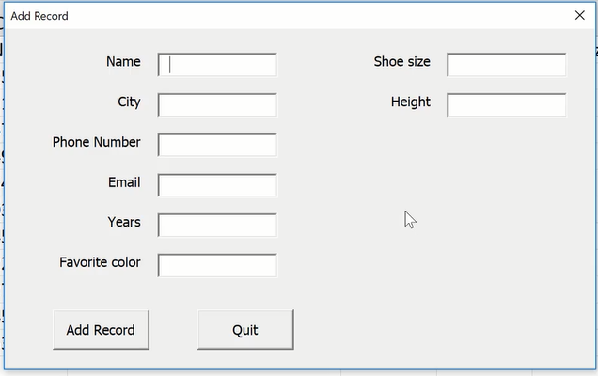
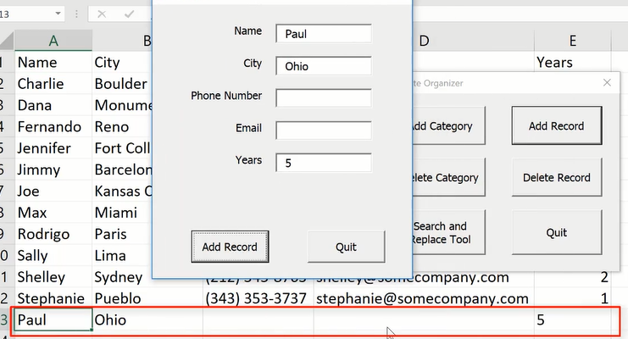
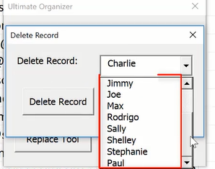
I've only got five categories but in general, you should allow up to 12.
Put a conditional statement in here so if there's six or fewer categories,
then the width of this user form be set to 250 pixels. Otherwise, if the number of categories is greater than six, then the width expands to I think around 450,
and there's another six of these hidden labels and input boxes over here to the right.
UserForm that counts the categories to determine the number of TextBoxes needed
UserForm with ComboBox to select with row to delete

Slide 3
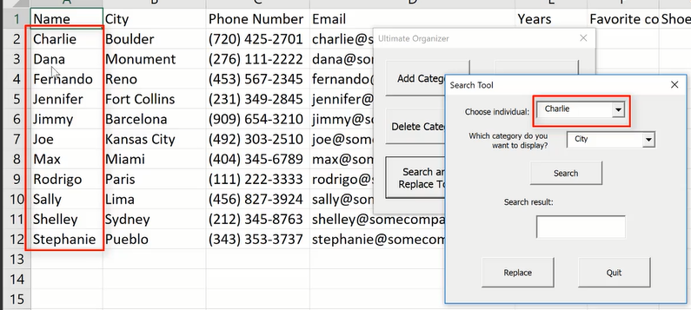
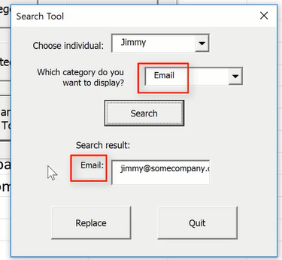
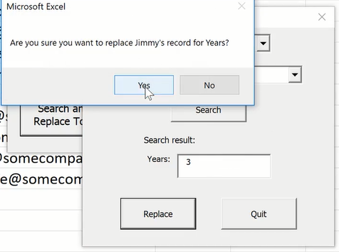
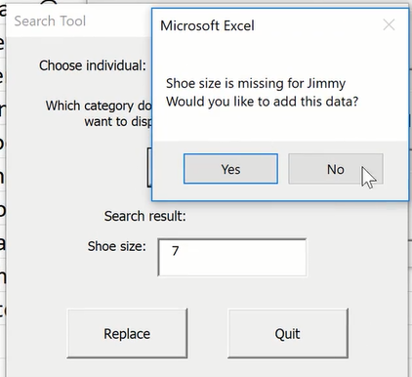
This is for Search and Replace. When Replace button is pressed, a new inputbox comes up to allow user to enter new info.
Populate first ComboBoxes with Names.
Populate second ComboBox with Categories
Assigned the Lable with the second ComboBox.Test
When Replace is pressed, it asks if user is sure.
If the searched data is blank, it asks if the user would like to add data, if Yes, inputbox pops up to allow user to add new data

